Slide 1


IT Ticket Analysis
FP20 ANALYTICS
FP20 ANALYTICS
Shalakya Sen
27/07/2025

Slide 2

ABOUT FP20 ANALYTICS
FP20 Analytics is a forward-thinking team of data problem-solvers dedicated to transforming complex information into clear, actionable insights that drive smarter decisions and long-term impact. With a strong blend of technical expertise and real-world business understanding, they deliver tailored dashboards, predictive models, and strategic solutions that help organizations thrive in a data-driven world. What truly sets FP20 apart is its vibrant, collaborative community of data enthusiasts where learning is hands-on, growth is continuous, and support is always available. Through portfolio projects, workshops, and mentorship, FP20 is not just shaping better analysts it’s also building a movement of confident, future-ready professionals.

Slide 3
AGENDA
Problem Statement
Insightful Observation
Data Overview &
Methodology
Dashboard & Strategic Suggestion
Conclusion
Objective Key Metrics & Visualization

Slide 4
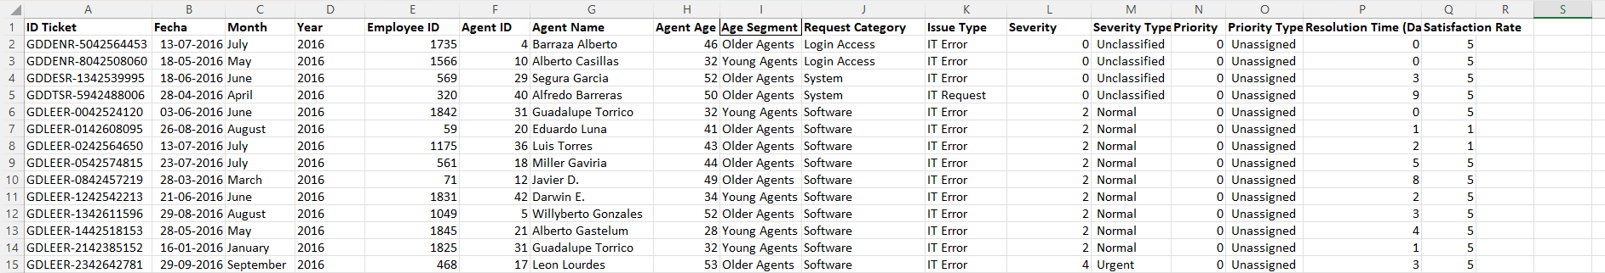
PROBLEM STATEMENT
You are tasked with analyzing the IT support ticket management system to understand the performance of IT agents, the efficiency of ticket resolution, and the satisfaction levels of employees. The objective is to identify high and low performers among IT agents, assess the overall effectiveness of the team, and pinpoint areas for improvement in the ticket resolution process. The ultimate goal is to make informed staffing decisions, including hiring, firing, and training, to enhance overall service quality and team performance.

Slide 5
DATA OVERVIEW
The dataset includes details for 97,498 Tickets with 17 columns capturing various attributes related to IT support operations. Here's a brief overview of the information available in the dataset :
Ticket ID: A unique identifier assigned to each IT ticket.
Fecha: The date when the ticket was created.
Employee ID: Unique identifier for the employee who raised the ticket.
Agent ID: Unique identifier for the support agent assigned to the ticket.
Agent Name: Full name of the supporting agent.
Agent Age: Age of the supporting agent.
Age Segment: Grouping of agents into "Young Agents" and "Older Agents" based on age.
Request Category: The category of the ticket request (e.g., Software, Hardware, Login Access, System).
Issue Type: Type of IT issue reported (mostly “IT Error” or “IT Request”).
Severity: Numeric severity level representing the urgency of the issue.
Severity Type: Description of the severity level (e.g., Normal, Urgent, Unclassified).
Priority: Numeric priority assigned to the ticket.
Priority Type: Label indicating priority status.
Resolution Time (Days): Number of days taken to resolve the ticket.
Satisfaction Rate: Rating given by the employee after the ticket was resolved (scale of 1–5).

Slide 6
Methodology
To explore and understand the data thoroughly, I applied the following methods and tools during the course of my analysis:
Data Cleaning:- Applied split to text column, and corrected the spelling of the inconsistent values to ensure clean and accurate data.
Data Enrichment:- Used VLOOKUP to pull in relevant fields from different sheets, enriching the dataset for better cross-referencing and deeper insights.
Descriptive Analysis:- Leveraged PivotTables to summarize key metrics such as ticket counts, resolution time, and satisfaction levels across years, categories, and age groups.
Trend Analysis:- Identified monthly and yearly patterns in ticket volume and satisfaction. Tracked peak times and fluctuations to forecast future IT support needs.
Segmentation:- Split data by agent seniority (Young Vs Older agents), ticket category (Hardware, Software, etc.) and priority to reveal patterns and pain points.
Visualization:- Created dynamic dashboards and charts in Excel for a clear, interactive representation of trends, agent performance, and key KPIs.

Slide 7
Objective Key Metrics and Visualizations

Slide 8
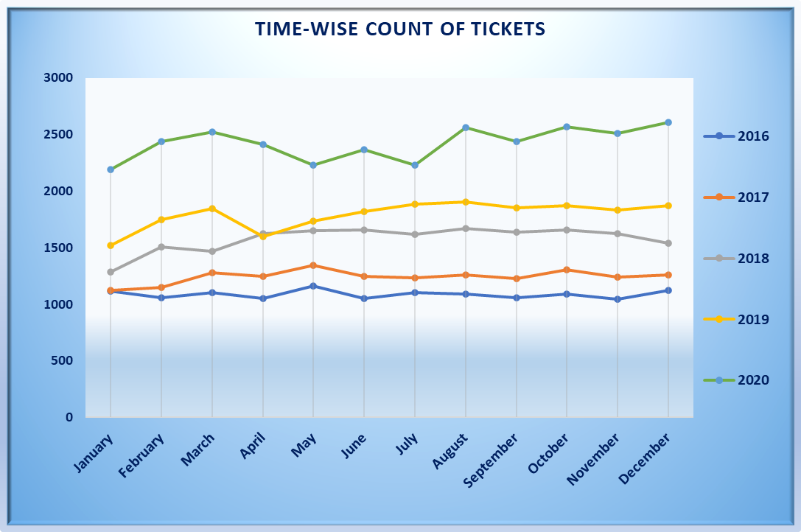
Time-wise Ticket Volume
From 2016 to 2020 the volume is gradually increasing & 2020 consistently leads in ticket count across all months. All years display a general upward trend from June to December, indicating seasonal or operational patterns influencing higher ticket volumes in the second half of the year.
We can allocate more resources like staff, supporting tools during Q3 and Q4, especially from August to December, to handle increased ticket volumes.
This chart can help the management to check the ticket volume & decide where to invest in the upcoming days.

Slide 9
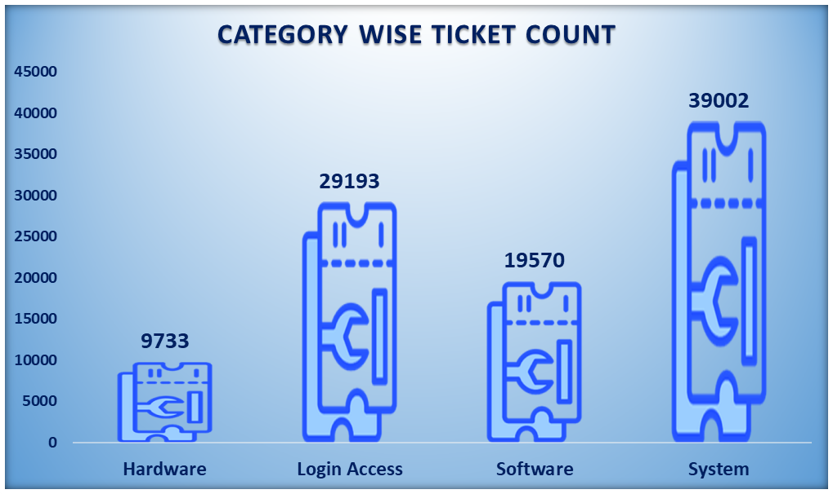
Category-wise Ticket Volume
System-related tickets dominate with a total of 39,002, indicating either complex infrastructure or major system issues. Login Access is the second-highest category with 29,193 tickets highlighting frequent authentication or access related problems. Hardware issues are the least reported, with 9,733 tickets showing either less dependency or better stability in hardware.
This chart can help the management to check the category wise volume of ticket & analyze where most of the problem arising from, which can lead in decision making where to invest in the upcoming days.

Slide 10
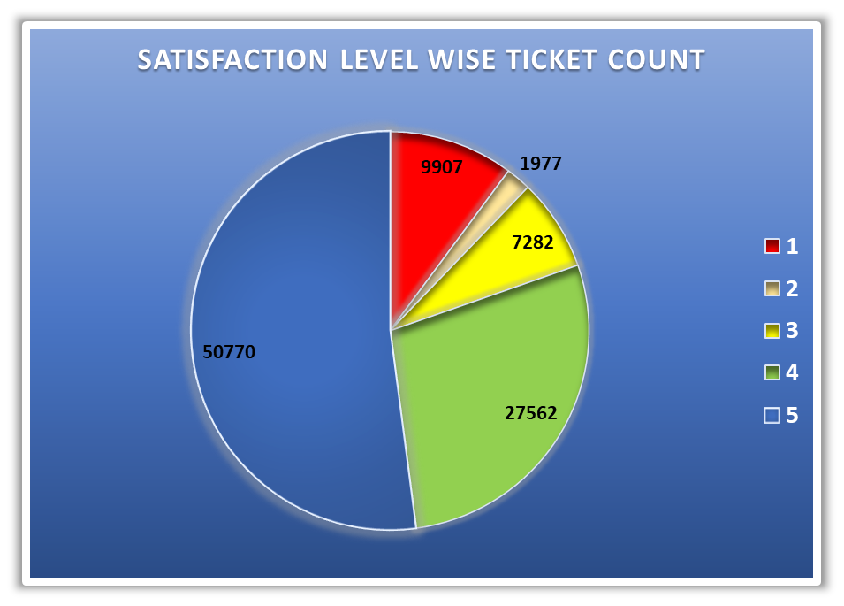
Satisfaction Level wise Ticket Count
Satisfaction Level 5 with 50,770 tickets a strong indicator of successful resolution and positive user experience.
We can investigate the root causes behind Level 1 and 2 feedback focus on response time & resolution accuracy.
We can consider using AI-driven sentiment analysis or ticket tagging to proactively flag risky tickets that might fall into lower satisfaction categories.

Slide 11
Insightful Observations

Slide 12
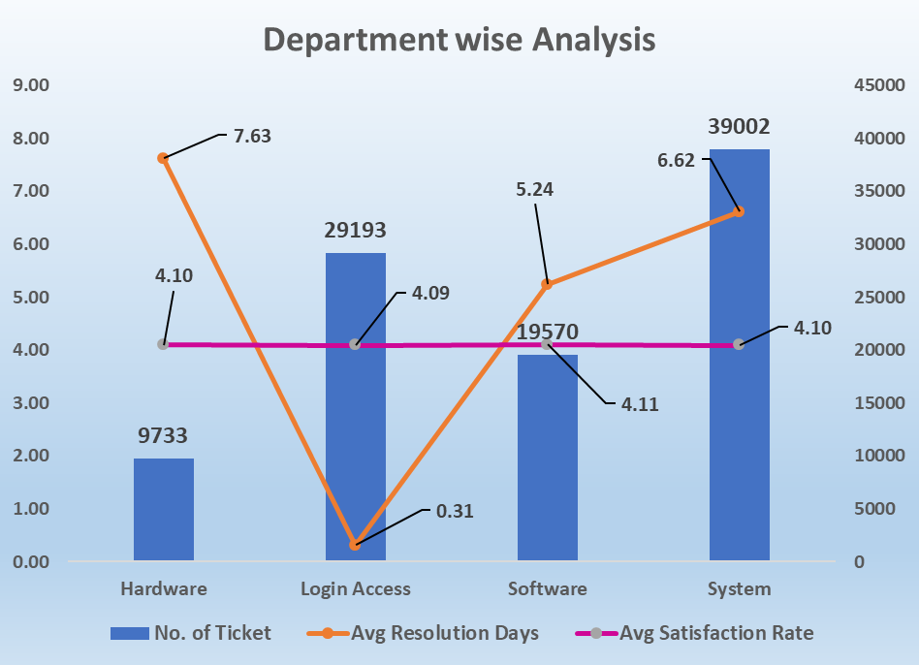
Department wise Core Analysis
We have to reduce resolution times in the Hardware department, which is the slowest despite the lowest ticket volume, indicating inefficiency or lack of resources.
We have to sustain the quick response time in Login Access but need to investigate why satisfaction is not higher despite speedy resolution.
This bar graph will help the management to plan department wise specific improvements, resource reallocation and also ensures balanced focus on speed, volume handling, and user experience.

Slide 13
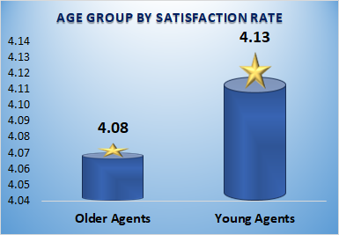
Satisfaction Rate wise Age Group
Young Agents have a higher average satisfaction rate of 4.13, compared to Older Agents at 4.08 the visual explains Young Agents are currently outperforming in customer experience delivery.
We can monitor whether the performance gap is widening or stable if increasing, it may indicate a need for systemic support for teams who are representing older agents.
This chart helps management to identify a slight performance gap between age groups, enabling targeted support to align satisfaction levels and maintain consistent service quality.

Slide 14
Suggested Agents who need Additional Training
Name | Average of Resolution Time (> 5 Days)
Sandra Lujan | 5.20
Barraza Alberto | 5.24
Rosa Olguin | 5.32
A. Trejo | 5.32
Griselda Galindo | 5.32
Armando Sierra | 5.34
Elena Velez | 5.38
Nurio Zepeda | 5.41
Mata Lucero | 5.45
Ramon Macias | 5.45
Lorena | 5.51
Estuardo Ocaño | 5.52
Jesus Contreras | 5.55
Grand Total | 5.39
List of employees who need additional training
Jesus Contreras
Estuardo Ocaño
Lorena
Ramon Macias
Mata Lucero
Nurio Zepeda
Elena Velez
Armando Sierra
Griselda Galindo
A. Trejo
Rosa Olguin
Barraza Alberto
Sandra Lujan
Miller Gaviria
Flores Sierra
Reyna Santacruz
Parra Luna
Luis Arguello
Aldo Carrillo
Velasquez Jose
Alfredo Barreras
Orci Carlos
Jesus Pacheco
Lopez Moran.
Guadalupe Villanueva
Alfonso Barraza
A total of 26 employees have been identified who need additional training. Immediate performance review and 1-on-1 training is recommended. We can assign mentors or supervisors to monitor real-time progress.
This list will help management to prioritize training resources effectively and builds a performance improvement pipeline for targeted development.
The tracking of before-and-after impact of training using resolution time and satisfaction metrics is advised.
Name | Average of Satisfaction Rate < 4
Luis Arguello | 3.82
Reyna Santacruz | 3.91
Alfredo Barreras | 3.67
Orci Carlos | 3.67
Velasquez Jose | 3.69
Aldo Carrillo | 3.78
Jesus Pacheco | 3.66
Miller Gaviria | 3.99
Flores Sierra | 3.99
Lopez Moran. | 3.64
Guadalupe Villanueva | 3.63
Parra Luna | 3.85
Alfonso Barraza | 3.04
Sandra Lujan | 3.60
A. Trejo | 3.59
Elena Velez | 3.62
Nurio Zepeda | 3.61
Lorena | 3.63
Estuardo Ocaño | 3.98
Grand Total | 3.70

Slide 15
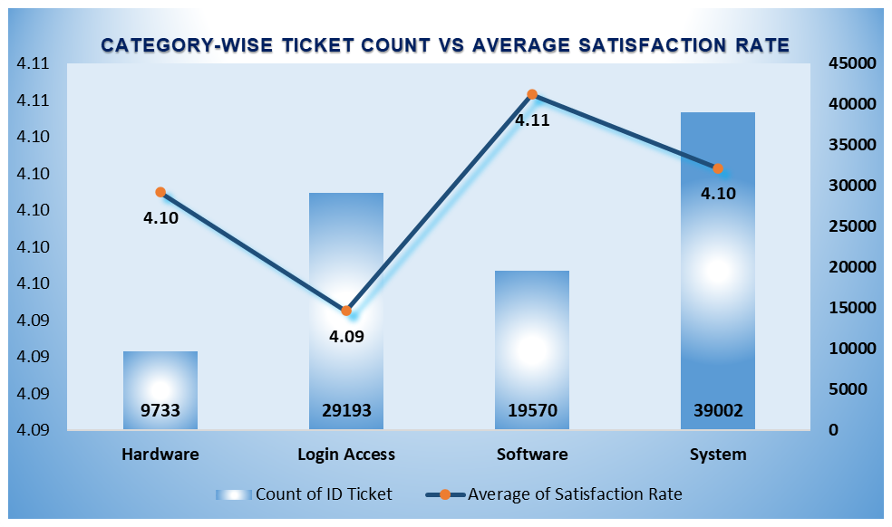
Category-wise Ticket Count vs Average Satisfaction Rate
We need to review Login Access processes to improve satisfaction possibly due to delays, user frustration, or access issues & study Software support practices as a model it's handling fewer tickets but achieving the highest satisfaction..
If we keep monitoring System and Hardware category closely, they handle large and small volumes, respectively, yet maintain strong satisfaction, showing good operational balance.
This chart helps management identify which ticket categories are delivering high customer satisfaction despite varying volumes, guiding where to replicate success and address weaknesses.

Slide 16
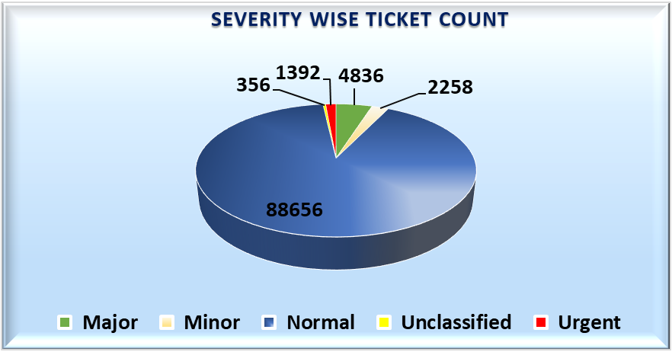
Severity wise Ticket Count
The normal issues overwhelm the system, helping management identify where support processes or automation are needed most. Even though urgent issues are few, they are critical to address fast this helps in planning escalation paths.
The presence of unclassified tickets indicates a break in ticket categorization, which can hinder accurate reporting and prioritization.
This chart helps management prioritize process improvements and resource allocation by highlighting the dominance of normal issues and gaps in ticket classification.

Slide 17
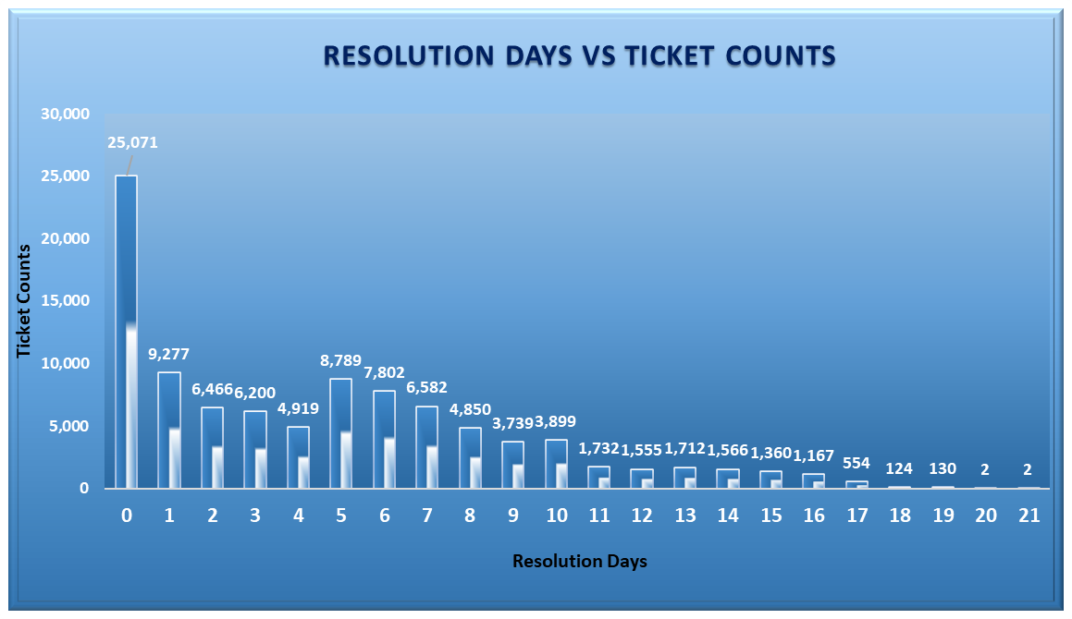
Resolution Time wise Ticket Count Analysis
This clearly shows that most tickets are resolved within 0–3 days, indicating strong performance in routine operations.
The long tail beyond 7 days reveals potential backlogs, escalations, or complex issues important for process improvement and resource planning.
We can consider setting internal benchmarks or alerts when tickets cross the 7-day mark, to drive quicker escalations or interventions.
This chart will help management to assess the resolution speed efficiency, spot delays, and identify areas where support processes may need optimization to reduce long-duration tickets.

Slide 18
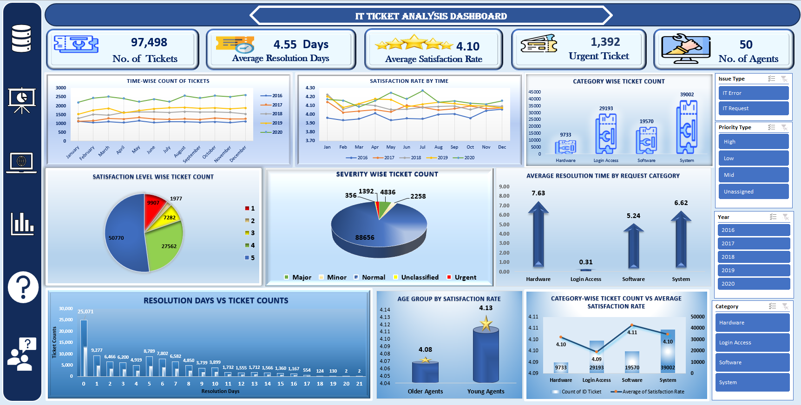
Dashboard
Based on all the insights gathered, I created an interactive dashboard featuring key charts and added slicers to make data visualization more dynamic and easier to explore.

Slide 19
Suggestions
STRATEGIC SUGGESTIONS:-
Accelerate ticket resolution for long-pending issues, a significant number of tickets take more than 7 days for getting resolved , we have to reduce these delays which will directly boost user trust and satisfaction.
Focus improvement on high impact categories like Login Access have high ticket volumes but slightly lower satisfaction these are key areas for impactful change.
Bridge the satisfaction gap across age groups, young agents show slightly higher satisfaction. Offering mentorship programs or better tech support to older agents could improve their experience and retention.
OPERATIONAL SUGGESTIONS:-
Automate first level responses for common issues like System and Login Access, automation or AI chatbots can reduce wait times and free up agent bandwidth.
Prioritize critical severity levels with expert teams Urgent and major issues, though fewer in number, but they need fast and expert resolution to maintain service credibility & better satisfaction level.
Monitor and act on resolution time trends weekly, regularly review tickets taking over 5–7 days to identify root causes be it process delays, knowledge gaps or tool limitations.

Slide 20
Conclusion
This analysis uncovers key insights into ticket resolution performance by examining trends across resolution days, ticket volume and handling efficiency. It highlights areas where service is quick and where delays are happening.
The dashboard uses clean visuals like bar charts and filters that make it easy to spot slowdowns, track SLA performance, and explore how different categories or teams are performing.
Filters like date, category, and resolution status allow users to focus on specific segments, helping teams drill down into root causes of delays or bottlenecks.
Insights such as how many tickets are resolved in the same day, which days or categories see the most delays, how resolution speed changes over time & empower IT teams to take focused, data-driven actions.
Ultimately, these insights will help managements & decision-makers to make smarter staffing, training and process changes to boost customer satisfaction and internal efficiency of the team.

Slide 21


